Slide 1
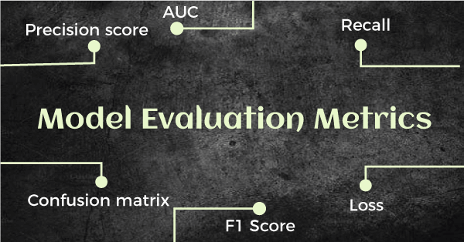
Performance Metrics for Classification & Regression Problem
2
- Dr. Sifat Momen (SfM1)

Slide 2
Learning goals
After this presentation, you should be able to
Appreciate the strengths of different classification and regression metrics
Understand and calculate precision, recall, F1-score
Understand the differences between macro and weighted scores
Understand and calculate MSE, RMSE, MAE, and R² score.

Slide 3
Jupyter Notebook
Please note that there is an associated Jupyter notebook with this presentation
Please use both in parallel for optimal understanding

Slide 4
How to Evaluate Models?
Classification Problem
Accuracy
Confusion Matrix (tool)
Precision
Recall
F1- score
Area Under the ROC curve (Not covered in this presentation)
Regression Problem
MSE, RMSE, MAE, R² score

Slide 5

Accuracy (Binary Classification Problem)
 | y_true | y_pred
1 | 1 | 1
2 | 0 | 0
3 | 1 | 1
5 | 0 | 0
6 | 1 | 1
8 | 0 | 0
10 | 0 | 0
 | y_true | y_pred
0 | 1 | 0
1 | 1 | 1
2 | 0 | 0
3 | 1 | 1
4 | 1 | 0
5 | 0 | 0
6 | 1 | 1
7 | 1 | 0
8 | 0 | 0
9 | 0 | 1
10 | 0 | 0
$Accuracy= \frac{7}{11}$ = 0.6363…
from sklearn.metrics import accuracy_score
accuracy_score(y_true, y_pred)

Slide 6
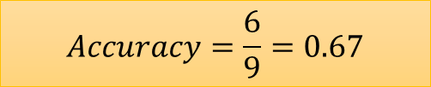
Accuracy (Multi-class Classification Problem)
 | y_true | y_pred
0 | cat | cat
1 | dog | cat
2 | mouse | mouse
3 | cat | cat
4 | cat | cat
5 | mouse | cat
6 | mouse | mouse
7 | dog | dog
8 | dog | mouse
 | y_true | y_pred
0 | cat | cat
2 | mouse | mouse
3 | cat | cat
4 | cat | cat
6 | mouse | mouse
7 | dog | dog
$$Accuracy=\frac{6}{9}=0.67$$
print('Accuracy: ', "{:.2f}".format(accuracy_score(y_true, y_pred)))

Slide 7
Weakness of the “Accuracy” Metric
It does not tell us anything about the type of error the model is making.
Example:
Say, we have a model that classifies whether an incoming email is spam of not spam and we have a model that classifies with an accuracy of 90%
This means that there exists a 10% error.
This metric does not tell anything about how much error is being made in each of the types of errors
Email is spam but classifies as non-spam
Email is non-spam but classifies as spam

Slide 8
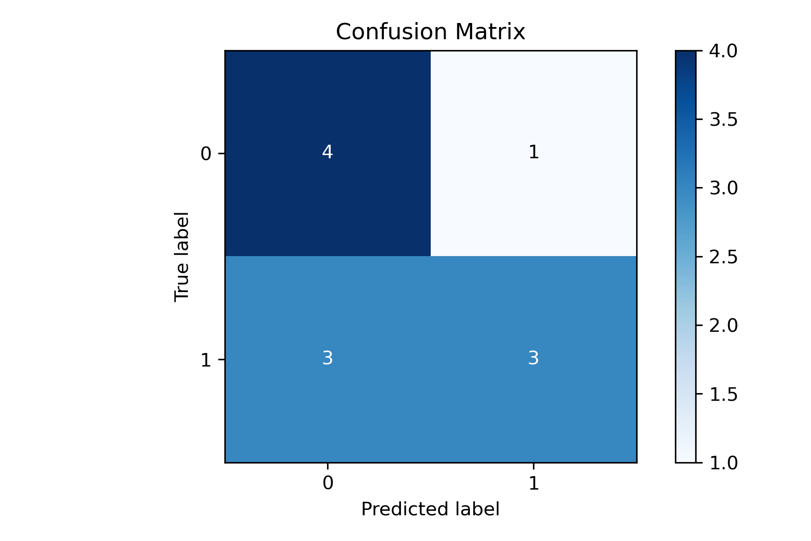
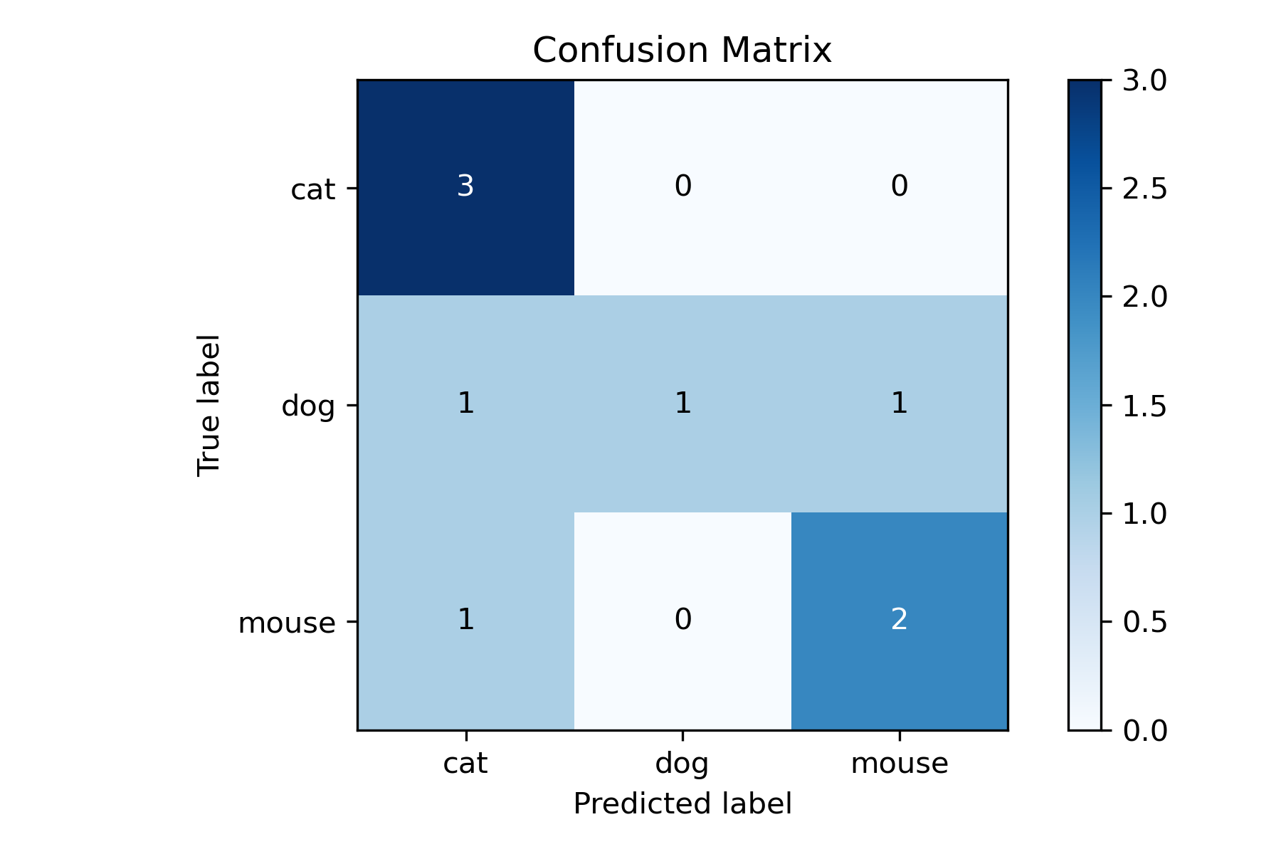
Confusion Matrix

Slide 9
Confusion Matrix
 | PREDICTED CLASS
ACTUAL CLASS |  | Class=Yes | Class=No
 | Class=Yes | a (TP) | b (FN)
 | Class=No | c (FP) | d (TN)
Most widely-used metric:
FP is Type I error
FN is Type II error

Slide 10
Class Imbalance Problem
Lots of classification problems where the classes are skewed (more records from one class than another)
Credit card fraud
Intrusion detection
Defective products in manufacturing assembly line
COVID-19 test results on a random sample
Key Challenge:
Evaluation measures such as accuracy are not well-suited for imbalanced class

Slide 11
Problem with Accuracy
Consider a 2-class problem
Number of Class NO examples = 990
Number of Class YES examples = 10
If a model predicts everything to be class NO, accuracy is 990/1000 = 99 %
This is misleading because this trivial model does not detect any class YES example
Detecting the rare class is usually more interesting (e.g., frauds, intrusions, defects, etc)
 | PREDICTED CLASS
ACTUAL CLASS |  | Class=Yes | Class=No
 | Class=Yes | 0 | 10
 | Class=No | 0 | 990

Slide 12
Which model is better?
 | PREDICTED
ACTUAL |  | Class=Yes | Class=No
 | Class=Yes | 0 | 10
 | Class=No | 0 | 990
A
Accuracy: 99%
 | PREDICTED
ACTUAL |  | Class=Yes | Class=No
 | Class=Yes | 10 | 0
 | Class=No | 500 | 490
B
Accuracy: 50%

Slide 13
Precision and Recall
When evaluating a search tool or a classifier, we are interested in at least two more performance measures:
Precision: Within a given set of positively-labeled results, the fraction that were true positives = TP/(TP + FP)
Recall: Given a set of positively-labeled results, the fraction of all positives that were retrieved = TP/(TP + FN)
Positively-labeled means judged “relevant” by the search engine or labeled as in the class by a classifier. TP = true positive, FP = false positive etc.

Slide 14
Precision (Which of the models is better?)
Model A
 | Sent to SPAM Folder | Not sent to SPAM folder
SPAM | 100 | 170
Not SPAM | 30 | 700
FP_{A} > FP_{B}
FN_{B} > FN_{A}
FP: Not Spam ➔ Spam
FN: Spam ➔ Not Spam
FP, in this context, is a more grievous error
In this context, Model B is better
 | Sent to SPAM Folder | Not sent to SPAM folder
SPAM | 100 | 190
Not SPAM | 10 | 700
Model B

Slide 15
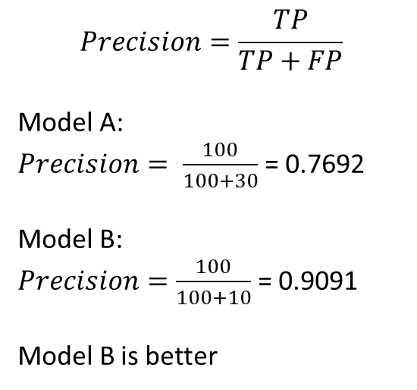
Precision (Which of the models is better?)
Model A
 | Sent to SPAM Folder | Not sent to SPAM folder
SPAM | 100 | 170
Not SPAM | 30 | 700
$$Precision=\frac{TP}{TP+FP}$$
Model A:
$Precision= \frac{100}{100+30}$ = 0.7692
Model B:
$Precision=\frac{100}{100+10}$ = 0.9091
Model B is better
 | Sent to SPAM Folder | Not sent to SPAM folder
SPAM | 100 | 190
Not SPAM | 10 | 700
Model B

Slide 16
Recall (Which of the models is better?)
 | Detected Cancer | Not Detected
Has Cancer | 1000 | 200
No Cancer | 800 | 8000
FP_{A} > FP_{B}
FN_{B} > FN_{A}
FP: No cancer ➔ Cancer
FN: Cancer ➔ No Cancer
Here, FN is a more grievous error
Hence, model A is better
Model A
 | Detected Cancer | Not Detected
Has Cancer | 1000 | 500
No Cancer | 500 | 8000
Model B

Slide 17
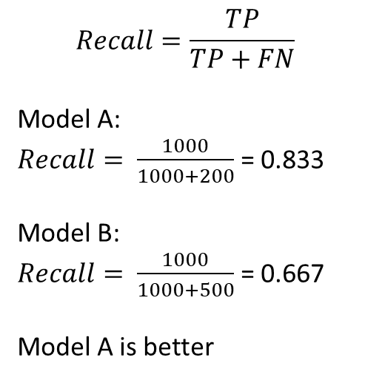
Recall (Which of the models is better?)
 | Detected Cancer | Not Detected
Has Cancer | 1000 | 200
No Cancer | 800 | 8000
$$Recall=\frac{TP}{TP+FN}$$
Model A:
$Recall= \frac{1000}{1000+200}$ = 0.833
Model B:
$Recall= \frac{1000}{1000+500}$ = 0.667
Model A is better
Model A
 | Detected Cancer | Not Detected
Has Cancer | 1000 | 500
No Cancer | 500 | 8000
Model B

Slide 18
Precision & Recall
If FN is a more grievous error, Recall is more important than precision
If FP is a more grievous error, Precision is more important that Recall

Slide 19
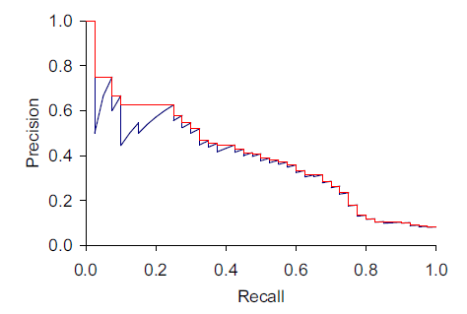
Precision-Recall Tradeoff
Search tools and classifiers normally assign scores to items. Sorting by score gives us a precision-recall plot which shows what performance would be for different score thresholds.
Score increasing

Slide 20
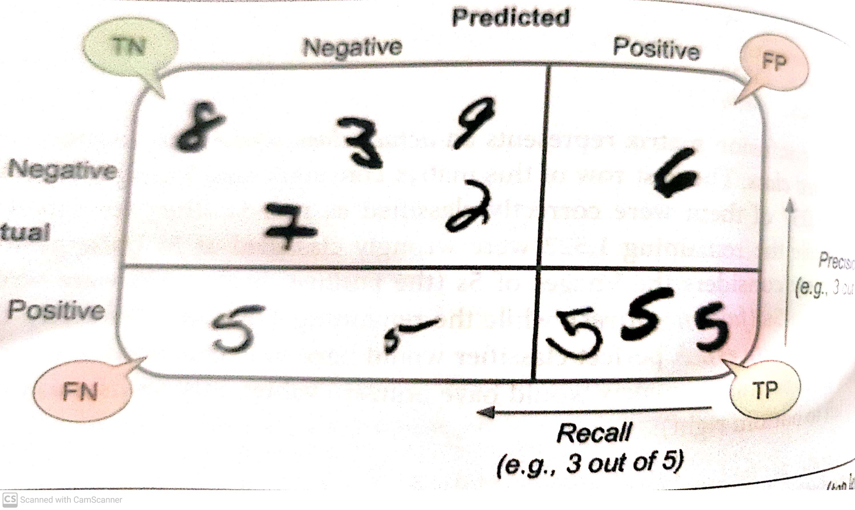
Confusion Matrix (Digit 5 to be correctly recognized)

Slide 21
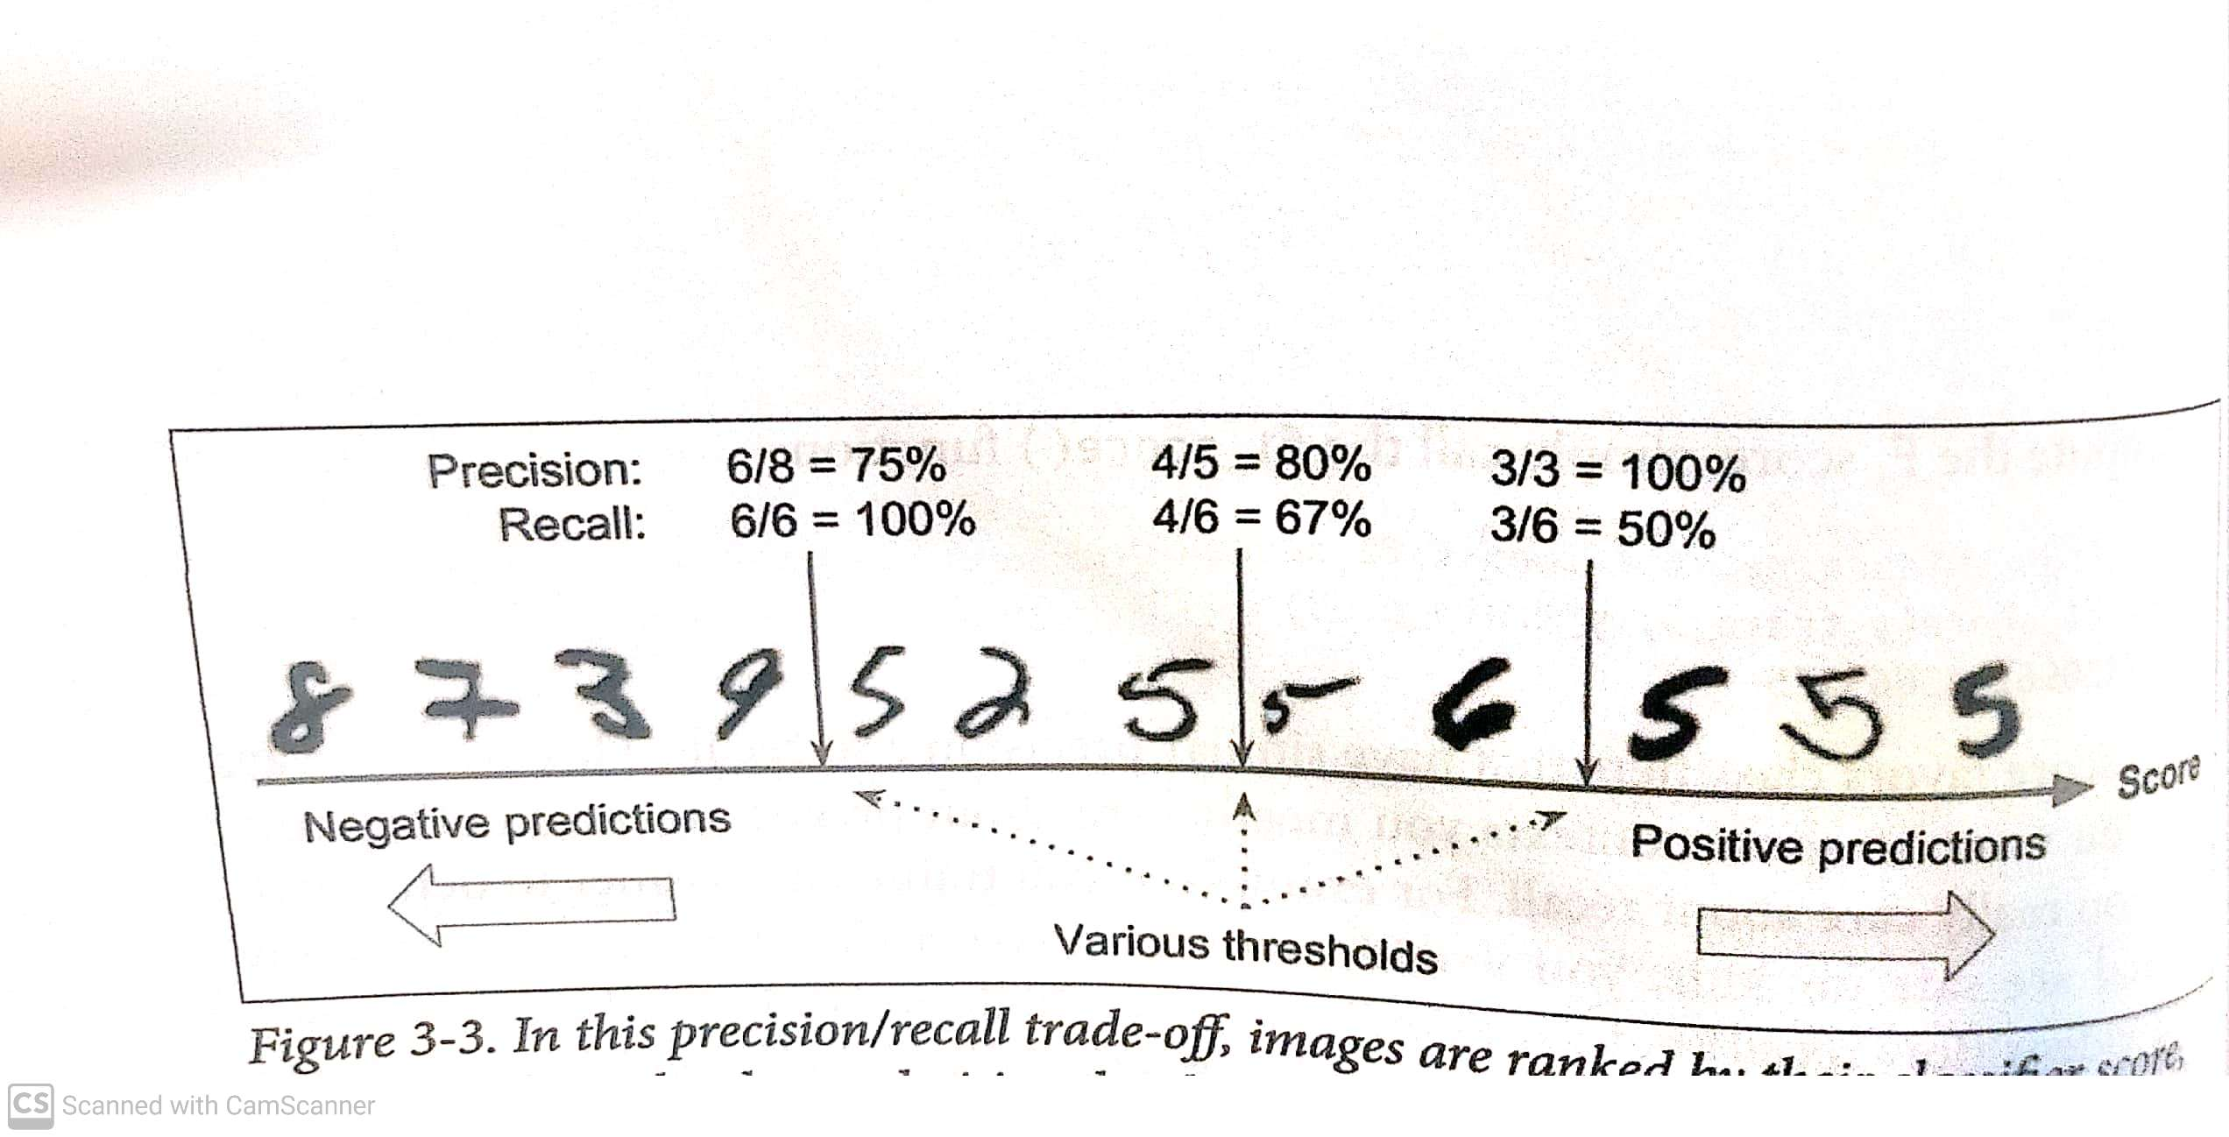
Precision- Recall Tradeoff

Slide 22
Precision-Recall Tradeoff
High precision would occur when FP is less
High recall would occur when FN is less
If you train a classifier to detect videos that are safe for kids, you would probably prefer a classifier that reject many good videos but keeps only the safe ones. In this case, you would like to keep FP less and hence you would likely to prefer a model with high precision over a model with high recall.
Suppose, you train a classifier that detects shoplifters in surveillance images. You may want to keep FN less and hence recall would be more important.

Slide 23
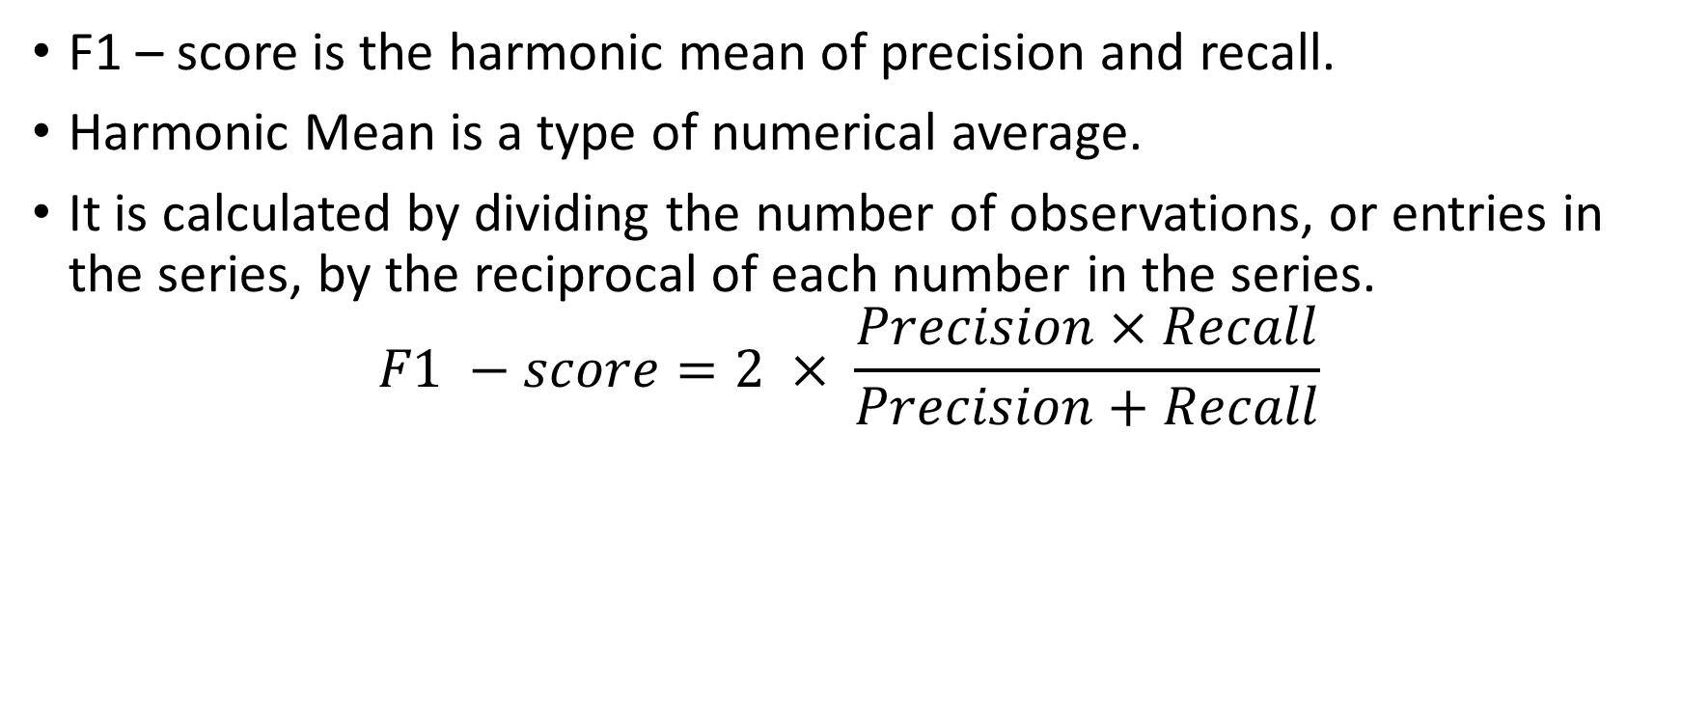
F1 – score
F1 – score is the harmonic mean of precision and recall.
Harmonic Mean is a type of numerical average.
It is calculated by dividing the number of observations, or entries in the series, by the reciprocal of each number in the series.
$$F1 −score=2 × \frac{Precision×Recall}{Precision+Recall}$$

Slide 24
Precision, Recall, F1 Score (Binary Classification Problem)
 | y_true | y_pred
0 | 1 | 0
1 | 1 | 1
2 | 0 | 0
3 | 1 | 1
4 | 1 | 0
5 | 0 | 0
6 | 1 | 1
7 | 1 | 0
8 | 0 | 0
9 | 0 | 1
10 | 0 | 0

Slide 25
Precision, Recall, F1 Score (Binary Classification Problem)
precision recall f1-score support
0 0.57 0.80 0.67 5
1 0.75 0.50 0.60 6
accuracy 0.64 11
macro avg 0.66 0.65 0.63 11
weighted avg 0.67 0.64 0.63 11

Slide 26
Precision, Recall, F1 Score (Multi-class classification problem)
 | y_true | y_pred
0 | cat | cat
1 | dog | cat
2 | mouse | mouse
3 | cat | cat
4 | cat | cat
5 | mouse | cat
6 | mouse | mouse
7 | dog | dog
8 | dog | mouse

Slide 27
Precision, Recall, F1 Score (Multi-class classification problem)
precision recall f1-score support
cat 0.60 1.00 0.75 3
dog 1.00 0.33 0.50 3
mouse 0.67 0.67 0.67 3
accuracy 0.67 9
macro avg 0.76 0.67 0.64 9
weighted avg 0.76 0.67 0.64 9

Slide 28
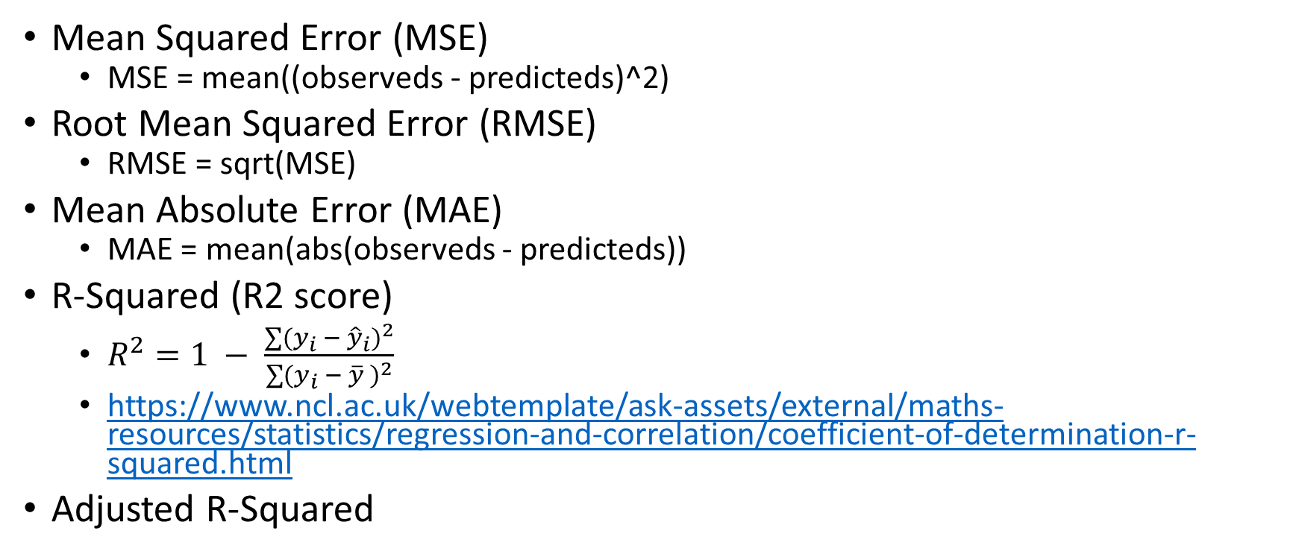
Performance Metric
Mean Squared Error (MSE)
MSE = mean((observeds - predicteds)^2)
Root Mean Squared Error (RMSE)
RMSE = sqrt(MSE)
Mean Absolute Error (MAE)
MAE = mean(abs(observeds - predicteds))
R-Squared (R2 score)
$R^{2}=1 − \frac{\sum{(y_{i} − {\hat{y}}_{i})^{2}}}{\sum{(y_{i}} − \overline{y} )^{2}}$
https://www.ncl.ac.uk/webtemplate/ask-assets/external/maths-resources/statistics/regression-and-correlation/coefficient-of-determination-r-squared.html
Adjusted R-Squared

